Slide 1


Comparative Study Of Single Marker Test (SMT) And Single Interval Mapping (SIM) For QTL Detection
By:
Eyas Rizik 208262733
Tamer Talhami 207443862

Slide 2

Introduction
QTL mapping problem:
Detect genome region (QTL) associated with quantitative trait:
Check if exists (has statistically significant effect).
Estimate effect.
Estimate position on the genome.
Solution:
Use marker-QTL association in parental lines.
Use backcross design to reduce associations with far markers.
Use monotony of physical and genetic distance.
Make calculation based on progeny trait values and numbers of corresponding genotypes in marker loci.
Our project: Creating tool for efficiency comparison of two methods in QTL mapping.

Slide 3
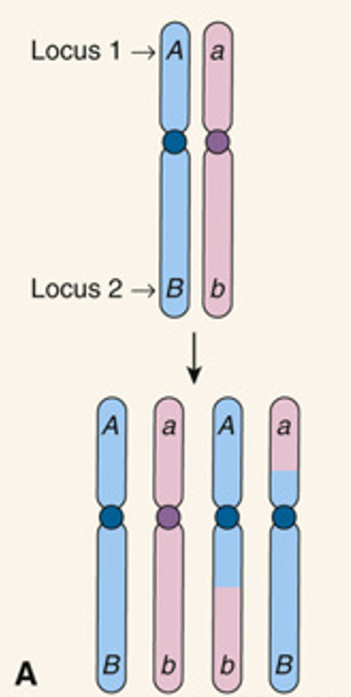


Reduction of associations by recombination
Advantages of Using Backcross Design: * Backcross design encourages more recombination, breaking up large inherited regions of DNA, so genes from both parents are shuffled more frequently, which reduces false associations between distant markers and the QTL.
How Associations Are Reduced: * Recombination separates distant markers from the true QTL over generations. * As a result, only markers closely linked to the QTL remain associated, filtering out false positives.
How We Measure Genetic Distance in Markers: * Genetic distance is derived from recombination frequencies observed in offspring. * Markers with low recombination frequency (r) are considered closely linked, while higher (r) indicates greater distance.
We Measure Genetic Distance Between Markers Using Haldane: We calculate genetic distance in centiMorgans (cM) , x_{m1} and x_{m2} are the genetic distance im m1 ,m2 marker

Slide 4
The Model
Two parental organisms: a) P1 (Pure Line - AA): One parent has a fixed genetic background. b) P2 (Hybrid - Aa): The second parent carries a mix of alleles.
Genotypic Structure: Each offspring inherits one allele from each parent, making them either AA (homozygous) or Aa (heterozygous).
Trait Association: The goal is to analyse how these genetic variations relate to quantitative traits.
Data Processing:
We use genetic markers across the genome to track inheritance.
The Haldane mapping function estimates recombination rates.
Methods like SMT and SIM determine where QTLs are likely located.

Slide 5
Comparison Criteria
Criteria | Single Marker Test (SMT) | Single Interval Mapping (SIM)
Approach | Tests markers individually | Analyzes intervals between markers
Resolution | Lower – may miss QTLs between markers | Higher – detects QTLs within an interval
Computational Cost | Fast and simple | More computationally intensive
Power & Sensitivity | Lower – may result in false negatives | Higher – uses flanking markers for accuracy
False Positives | Higher – requires correction for multiple tests | Lower – likelihood-based approach

Slide 6

How SIM Works
Works by analysing intervals between genetic markers instead of treating each marker independently.
Step 1: Select an Interval:
Instead of testing individual markers, SIM examines a genetic interval between two flanking markers.
Step 2: Estimate the Likelihood of a QTL:
A statistical model is used to predict the probability of a QTL existing within the interval.
Maximum Likelihood Estimation (MLE) is applied to calculate LOD scores at different positions.
where : L : The likelihood of the data given a QTL is present in the interval
L₀ : The likelihood of the data given no QTL is present

Slide 7
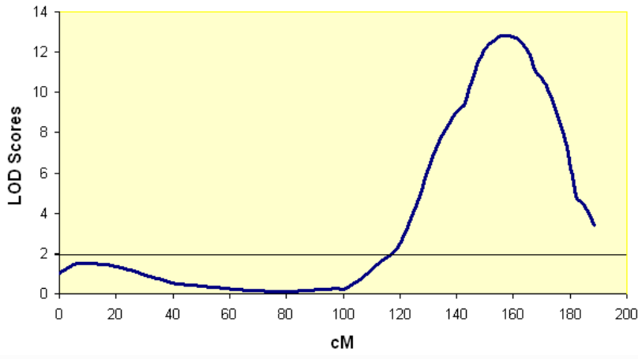
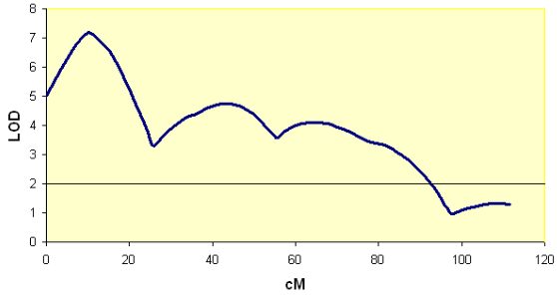
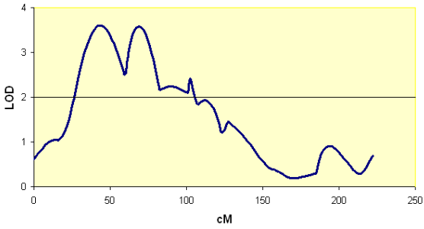
Step 3: LOD Score Analysis:
The LOD score measures how strong the evidence is for a QTL in the tested region.
Higher LOD scores indicate a higher likelihood of a true QTL.
Step 4: Significance Testing:
Permutation tests are used to determine whether the detected QTL is statistically significant.This test gives a threshold If the actual LOD score from the data exceeds this threshold, the QTL is considered statistically significant and unlikely to have appeared by random chance.
Step 5: QTL Position & Effect Estimation:
If a peak LOD score surpasses a threshold, a QTL is considered detected.
The location and effect of the QTL on the trait are recorded.

Slide 8

How SMT Works
In SMT, each genetic marker is tested separately and the purpose of SMT is to test whether there is a statistical relationship between a single genetic marker and a quantitative trait.
For this purpose, we perform as a first step - linear regression to check whether the marker affects the trait.
The central equation in SMT is a linear regression model:
Ti​: Trait value for individual i.
μ: Average of the trait in the population.
β: coefficient that represents how strong is the effect of the genetic marker on the trait.
: Genotype of individual i at marker m. (Gim= 0,1,2 -> aa,Aa,AA Respectively)
ϵi​: Residual error, assumed ϵi∼N(0,σ2).

Slide 9


(β) Calculation
The genotype of individual i.
The average of the genotypes at the marker m.
The value of the trait of individual i.
The average of the trait in the population.
Second step - Statistical hypotheses:
To test whether the marker really affects the trait, we define two hypotheses:
Null hypothesis (H₀): There is no relationship between the marker and the trait → β=0 (So the marker does not affect the trait).
Alternative hypothesis (H₁): There is a relationship → β≠0 (So there is an effect of the marker on the trait).

Slide 10

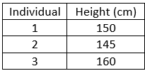
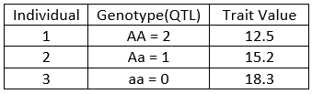
What Data Do We Use?
🧬 Genotypic Data
Extracted from VCF files (genetic marker positions & variants).
📊 Phenotypic Data
Single quantitative trait measured for each individual.
🖥️ Simulated Data
Generated in R/qtl to test different QTL mapping conditions.
✅ Why This Data?
Helps us identify QTL positions.
Enables comparison of SMT & SIM.
Balances real & simulated data for accurate analysis.

Slide 11



Research Process
Step 1: Data Preparation
Step 2: QTL Detection with SMT & SIM
Step 3: Visualization
Real Data: Extract and preprocess genetic marker and trait data from VCF files.
Identify QTLs positions using SMT or SIM methods.
Generate Manhattan plots to visualize marker associations.

Slide 12
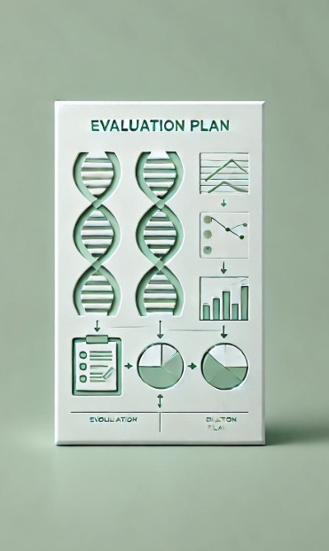
Evaluation Plan
🔹 How We Evaluate Our Methods?
✅ Key Metrics:
Accuracy – How well detected QTLs match known positions.
Statistical Power – Detecting real QTLs & avoiding false negatives.
False Discovery Rate (FDR) – Checking false positives.
✅ Testing Datasets:
Simulated Data – Varying conditions (marker density, noise).
Real Data – Preprocessed VCF files for validation.
✅ Methodology:
Apply SMT & SIM, analyze performance.
Graphs & tables summarize QTL positions & significance.

Slide 13

CONCLUSION
This study provides insights into selecting QTL mapping methods based on dataset characteristics. SIM is recommended for high-precision studies, while SMT is useful for preliminary analyses. These findings contribute to improve genetic mapping techniques in biological and agricultural researches.
Thank You

